Slide 1
Intro to Deep Learning

Slide 2
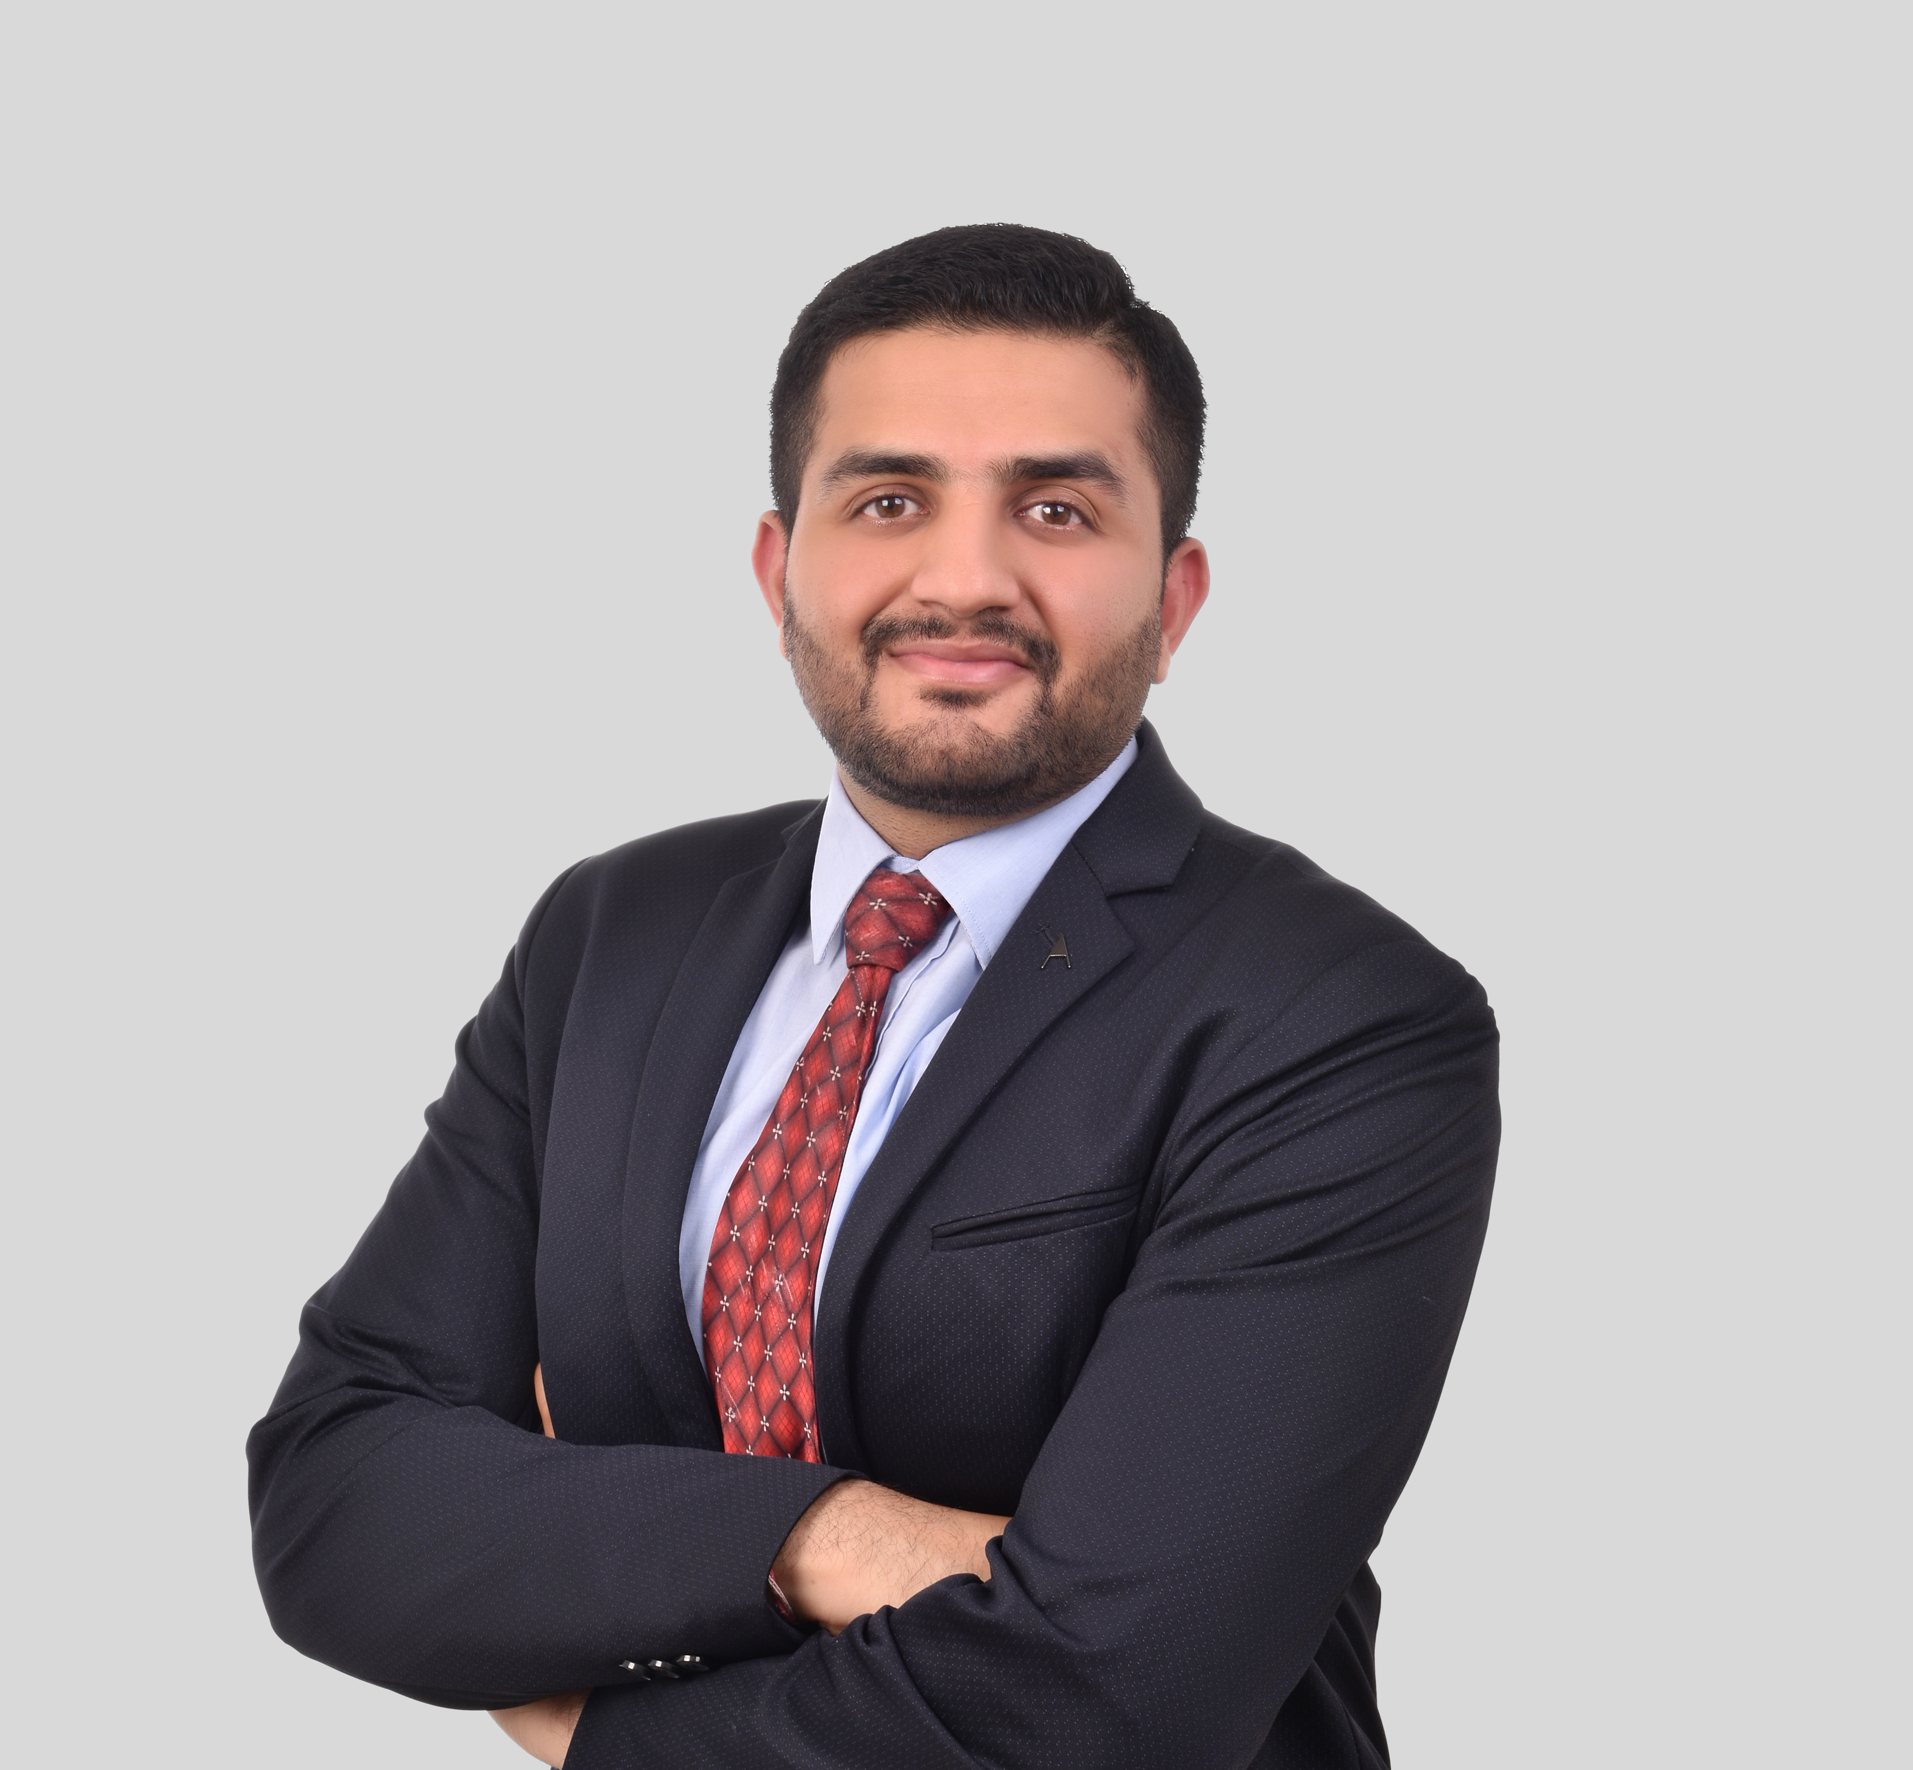
HELLO!
I am Arpit Jain
I am here because Data Science is my passion and I love sharing my expertise with people.

Slide 3
Agenda
What is Deep Learning -
RNN
LSTM
GRU
Seq 2 Seq Model
Use Cases –
Weather Prediction
Gold Pricing
Advanced NLP -
Vecotrizations
Word Embeddings
Transformers –
Intro and core improvements
GPT
BERT
1

Slide 4
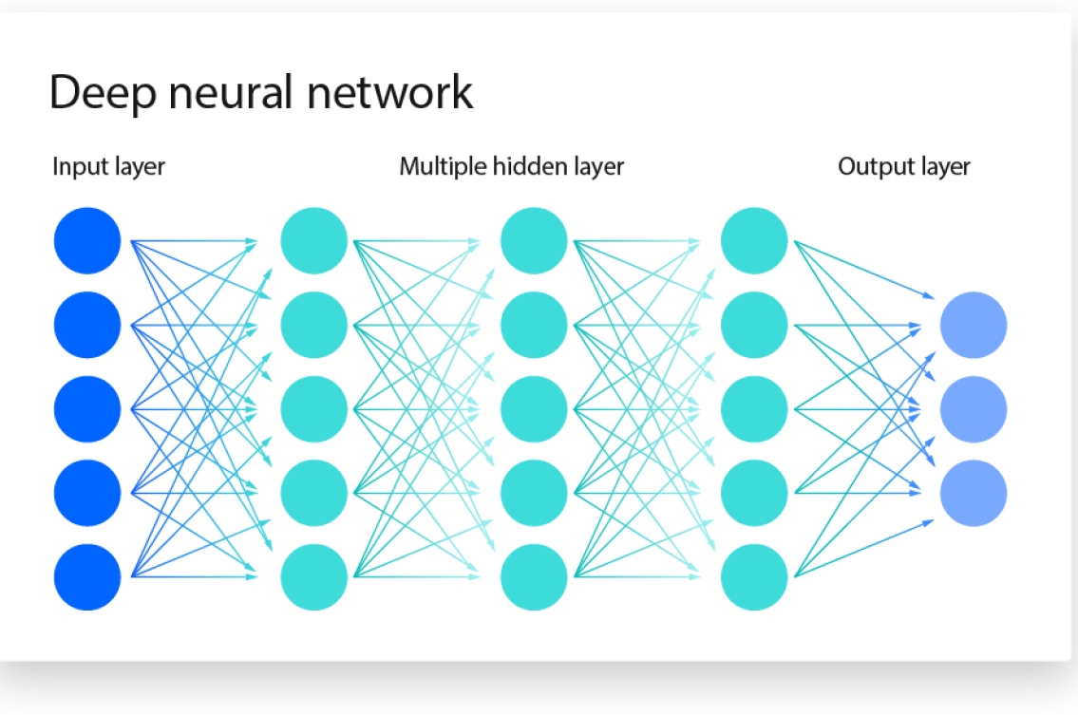
Deep Learning

Slide 5
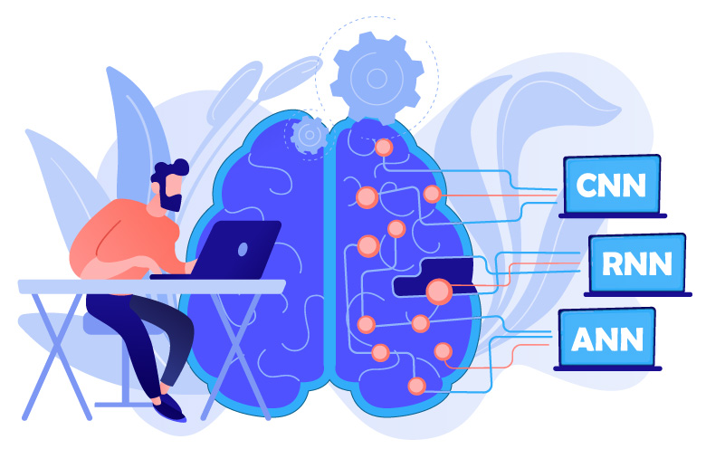
Types of Deep Learning

Slide 6
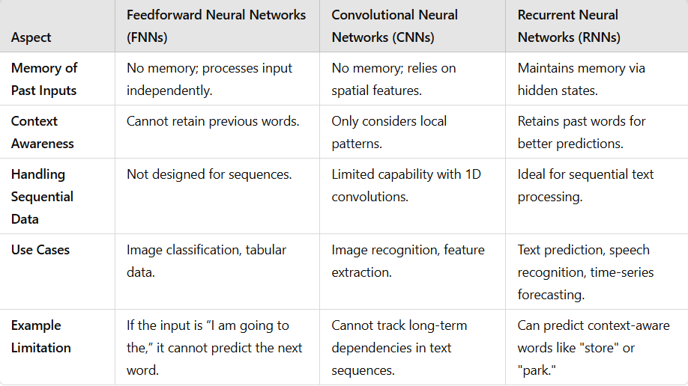
RNN

Slide 7
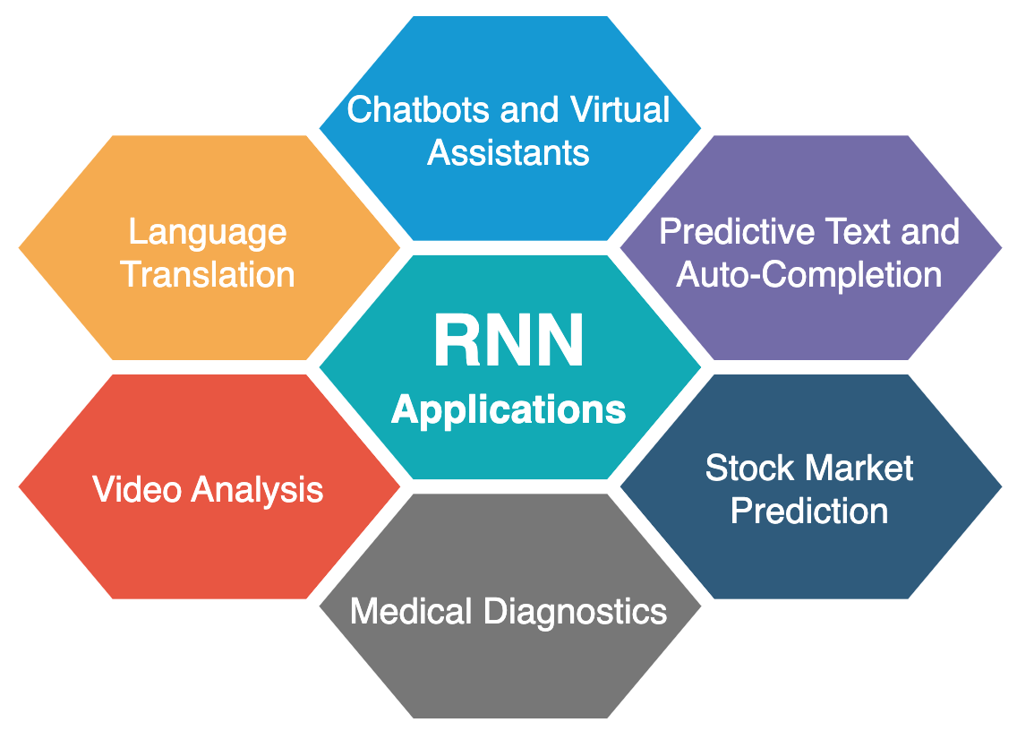
RNN Applications

Slide 8
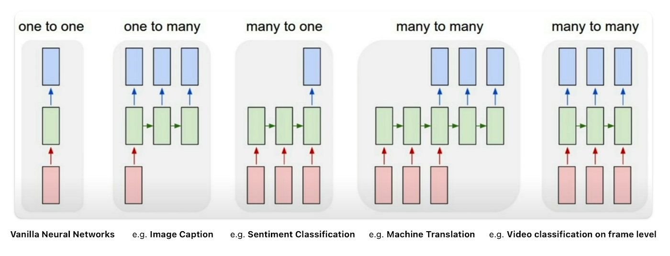
Structure of RNN Cell

Slide 9
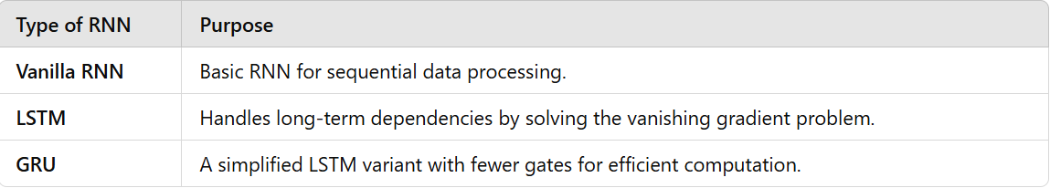
Types Of RNN

Slide 10
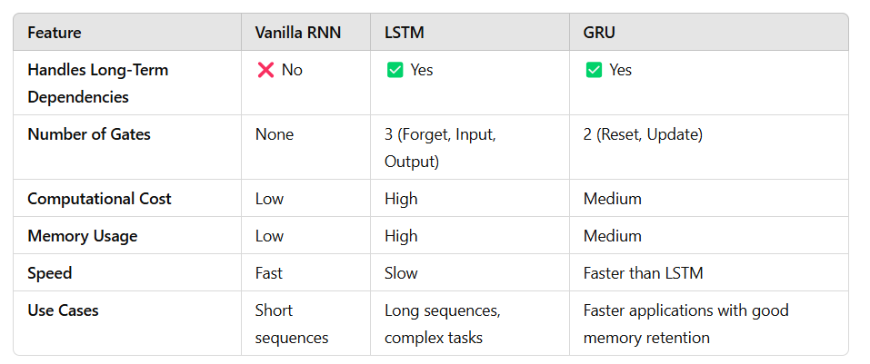
RNN vs LSTM vs GRU

Slide 11
Use Case Seattle Weather Prediction

Slide 12
Use Case Gold Pricing

Slide 13
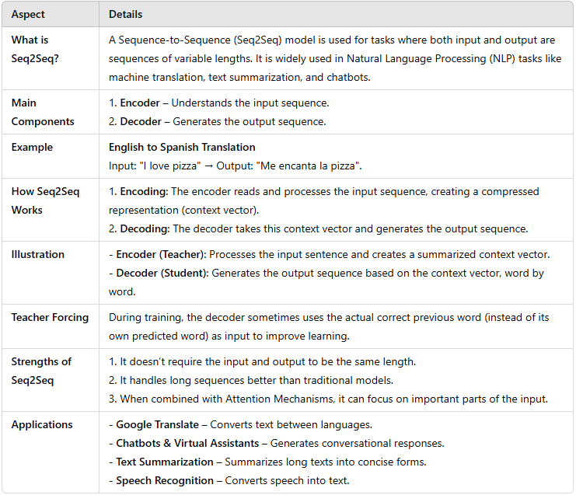
Seq 2 Seq Models

Slide 14
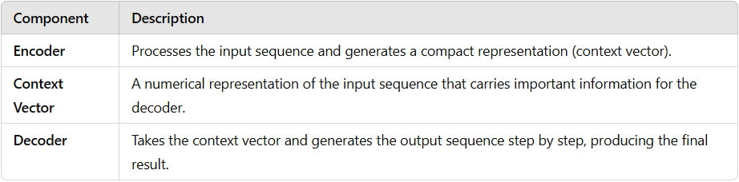
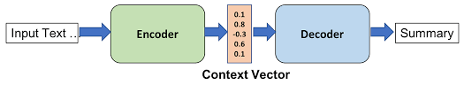
Encoder Decoder Architecture

Slide 15
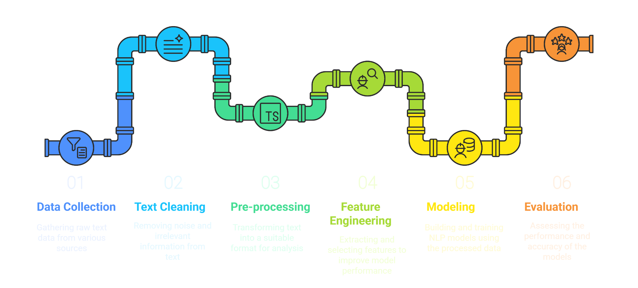
NLP Pipeline

Slide 16
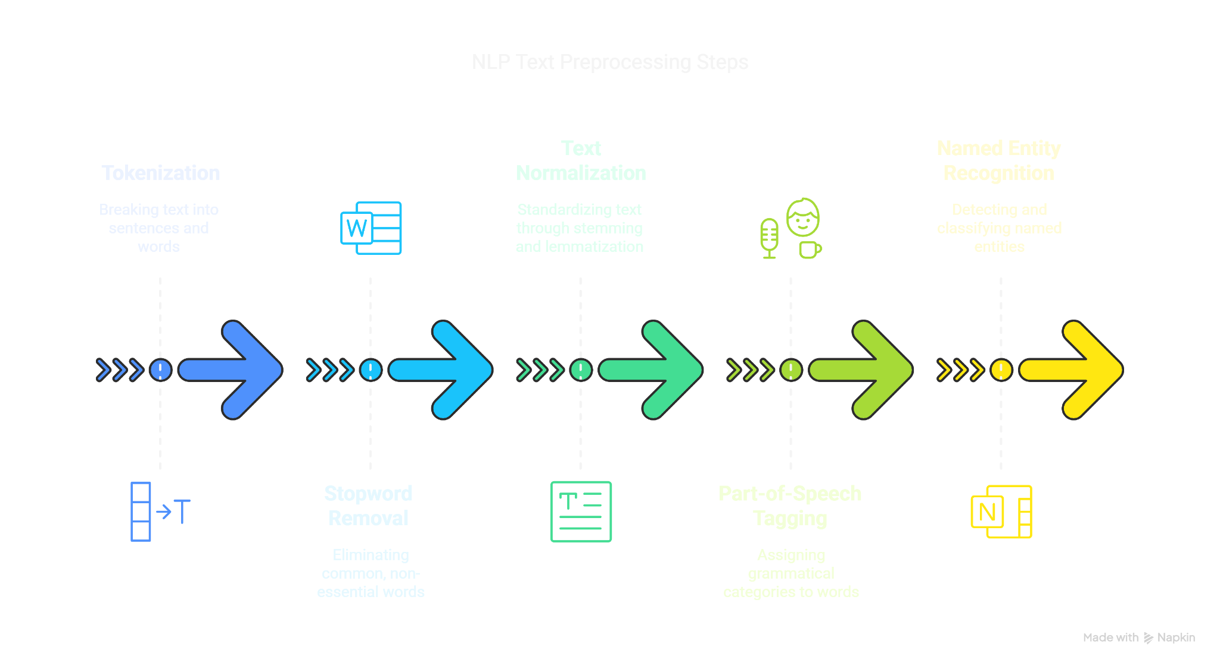
Text Pre Processing

Slide 17
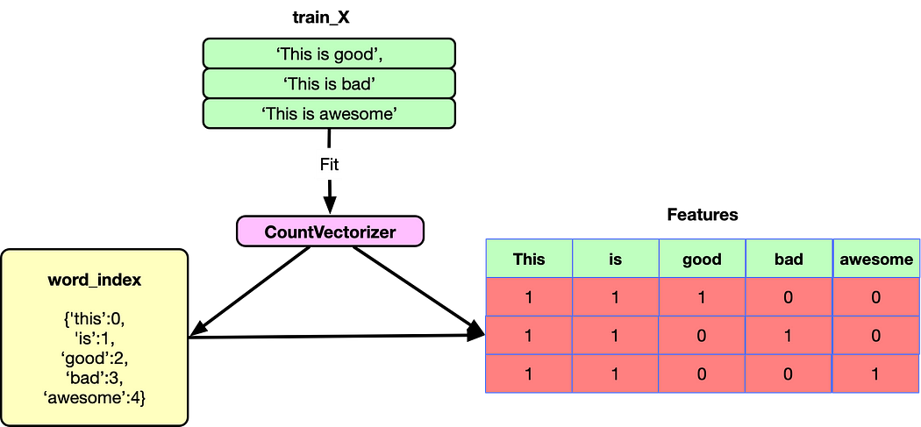
Vectorization - Count

Slide 18
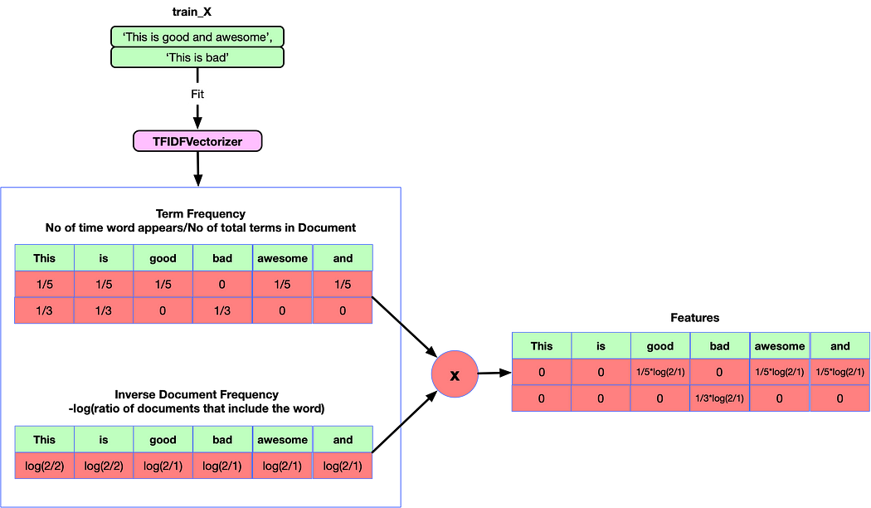
Vectorization – TF-IDF

Slide 19
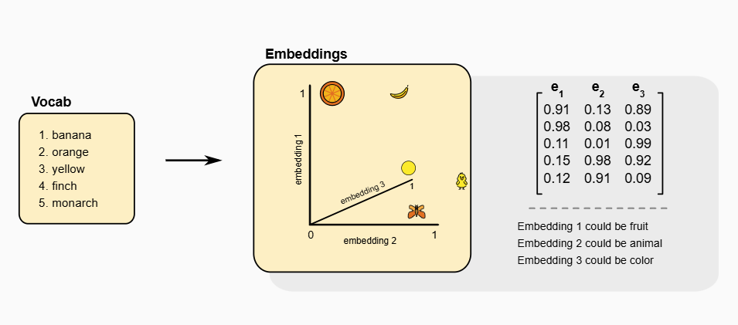
Word Embeddings

Slide 20
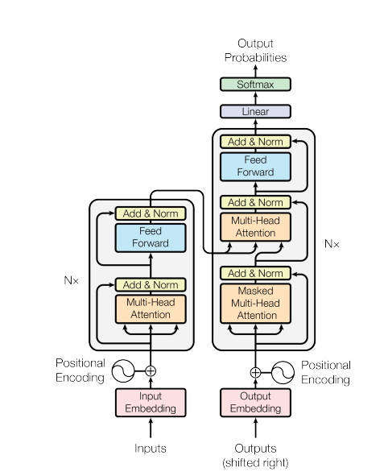
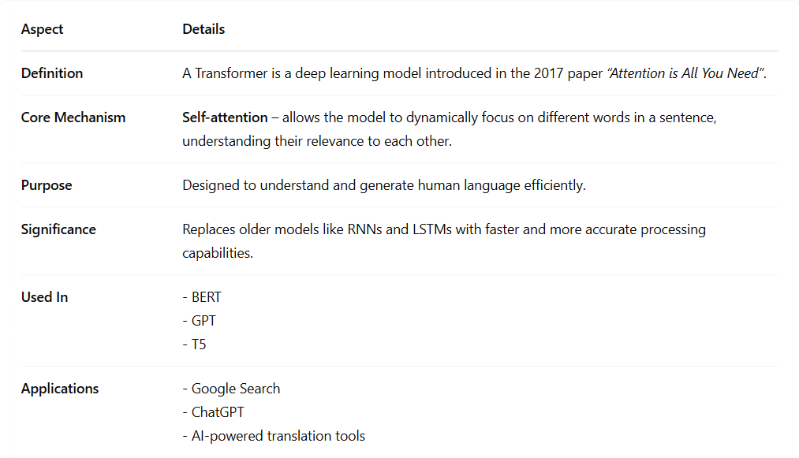
Intro to Transformers

Slide 21
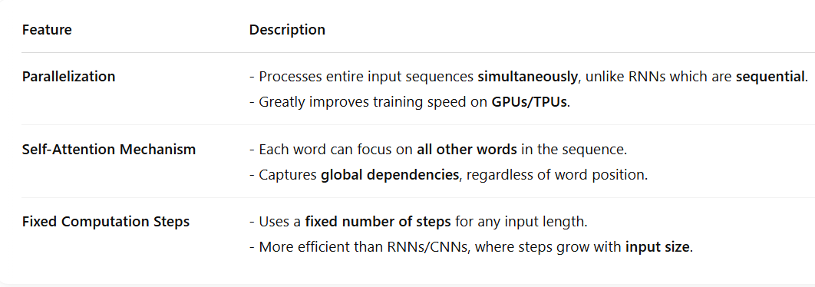
Core Features

Slide 22
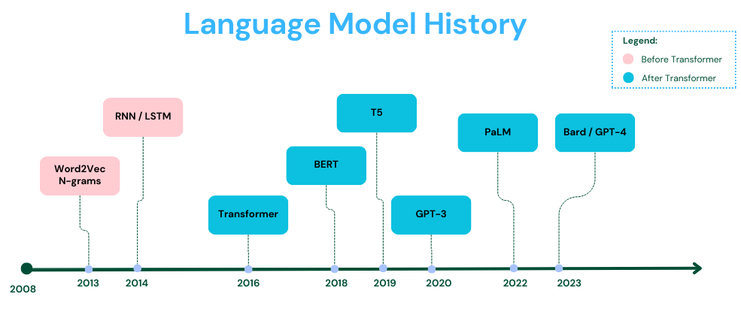
LLM Model History

Slide 23
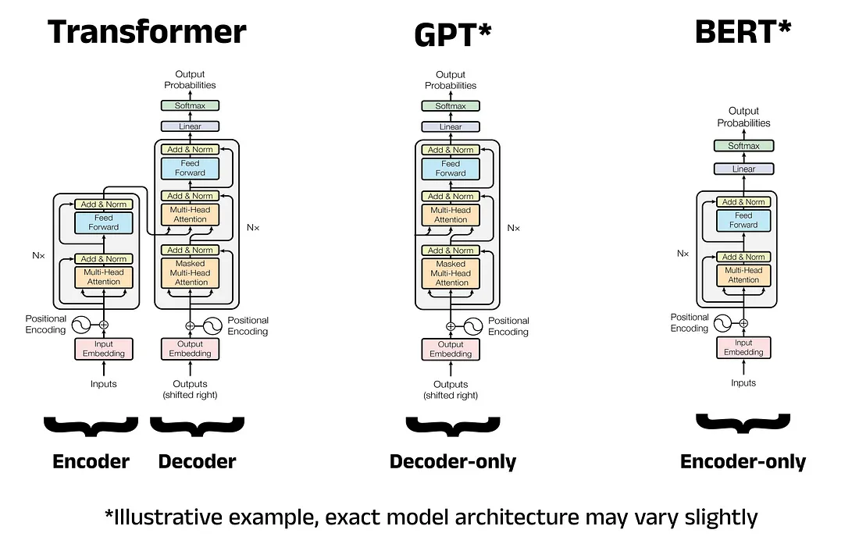
Type Of Transformers Architecture

Slide 24
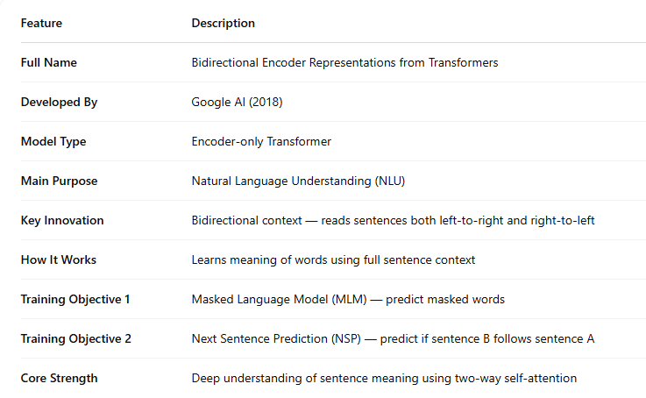
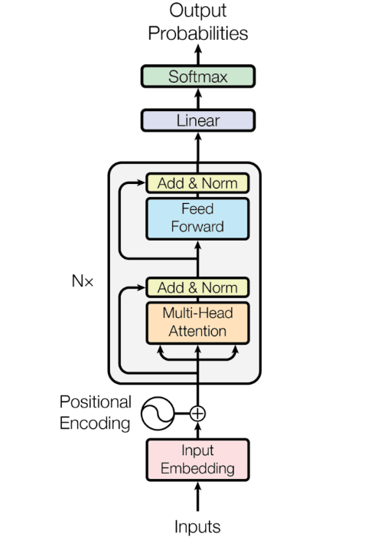
Bert Model

Slide 25
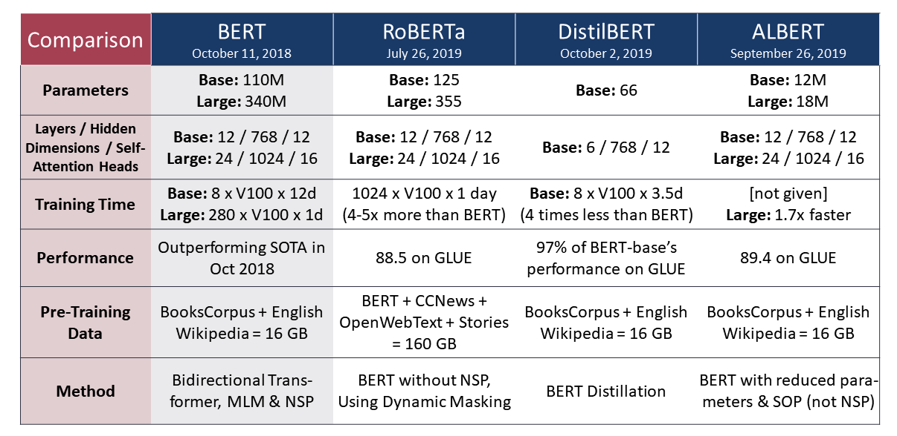
Variants Of Bert

Slide 26
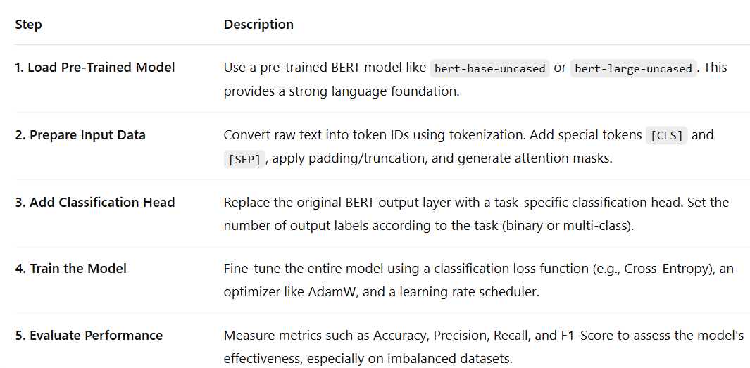
Fine Tuning Bert Model

Slide 27
Use Case Bert Text Classifier

Slide 28

Thank You

